Slide 1

#LifeKoKaroLift
Linear Regression Kickstart Session

Slide 2


Course : Data Science
Lecture On : Linear Regression
Instructor : Sumit Shukla

Slide 3

Machine Learning
Do You Guys Want To Play A Game??

Slide 4
Machine Learning
Input1 | Input2 | Output
1 | 2 | 1.00
2 | 4 | 2.00
4 | 6 | 3.33
5 | 9 | 4.67
3 | 1 | 1.33
9 | 0 | 3.00
3 | 6 | 3.00
Given the above data, decode the relationship between input1, input2 and output.
If you are able to decode the relationship between inputs and output, please write yes on the chat section and don’t share anything about the relationship.

Slide 5
Machine Learning
Input1 | Input2 | Output
10 | 4
Based on the learning that you have obtained from the previous data(slide), please find out the output for the given inputs in the above table.
PS: Please just share your answers on the chat section and don’t share the explanation.

Slide 6
Machine Learning
Machine Learning Flowchart
x1 | x2 | x3 | y
Machine Learning Algorithm
Making predictions
Decoding the relationship between various inputs and outputs
Historical Data/ Past Data
Once the learning is completed, we use that learning to make predictions on unseen data

Slide 7
Machine Learning
Input1 | Input2 | Output |  | Input1 | Input2 | Output
1 | 2 | 1.00 |  | 1 | 2 | A
2 | 4 | 2.00 |  | 2 | 4 | A
4 | 6 | 3.33 |  | 4 | 6 | B
5 | 9 | 4.67 |  | 5 | 9 | B
3 | 1 | 1.33 |  | 3 | 1 | B
9 | 0 | 3.00 |  | 9 | 0 | A
3 | 6 | 3.00 |  | 3 | 6 | A
Input1 | Input2 | Output |  | Input1 | Input2 | Output
10 | 4 |  |  | 10 | 4

Slide 8
Machine Learning
marketing_budget(thousands) | actual_sales(millions)
187.86 | 12.14
138.13 | 12.33
177.89 | 8.41
181.13 | 8.9
151.5 | 12.57
106.87 | 11.3
160.94 | 11.66
140.09 | 10.93
132.58 | 11.99
Assume that you work for a Marketing Firm and your CEO requires you to tell her the rough estimate of the sales that would happen the next month. You already have the data(present on the right). Using the following data, try to find out the rough estimate of the sales that would happen the next month.
PS: Remember as of now you don’t know anything about Linear Regression or any complex ML Algorithm. Try to solve this task with your logical understanding and simple maths.

Slide 9
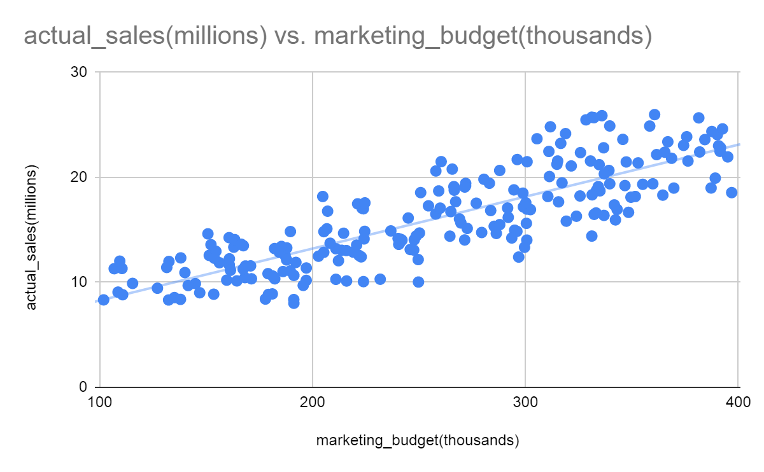
Machine Learning

Slide 10
Machine Learning
marketing_budget(thousands) | actual_sales(millions)
187.86 | 12.14
138.13 | 12.33
177.89 | 8.41
181.13 | 8.9
151.5 | 12.57
106.87 | 11.3
160.94 | 11.66
140.09 | 10.93
132.58 | 11.99
TV Budget | Radio Budget | Social Media Budget | Sales
16 | 6.566 | 2.908 | 54.733
13 | 9.238 | 2.410 | 46.678
41 | 15.886 | 2.913 | 150.178
83 | 30.020 | 6.922 | 298.246
15 | 8.437 | 1.406 | 56.594
29 | 9.614 | 1.027 | 105.889
55 | 24.894 | 4.274 | 198.680
31 | 17.355 | 2.290 | 108.734
76 | 24.649 | 7.130 | 270.189
13 | 0.431 | 2.229 | 48.281

Slide 11
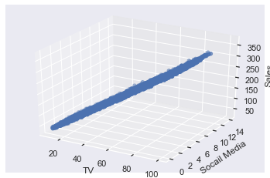
Machine Learning
TV Budget | Radio Budget | Social Media Budget | Sales
16 | 6.566 | 2.908 | 54.733
13 | 9.238 | 2.410 | 46.678
41 | 15.886 | 2.913 | 150.178
83 | 30.020 | 6.922 | 298.246
15 | 8.437 | 1.406 | 56.594
29 | 9.614 | 1.027 | 105.889
55 | 24.894 | 4.274 | 198.680
31 | 17.355 | 2.290 | 108.734
76 | 24.649 | 7.130 | 270.189
13 | 0.431 | 2.229 | 48.281
https://chart-studio.plotly.com/create/?_ga=2.31751993.681745274.1655462537-1389402734.1655462537#/

Slide 12
Machine Learning
Sales = -0.989 + 3.5*(TV Budget) + 0.1*(Social Media Budget)

Slide 13
Machine Learning
Introduction to Linear Regression
You are the CEO of a hypermarket chain and you want to open new store which should give me the best sales . What all factors will you be looking at before selecting the best location that can offer you the best sales?
• The hypermarket chain has more than 5000 stores across the world
• It is upstream hypermarket store catering to high end products
• There are more than 100 locations he needs to choose from

Slide 14
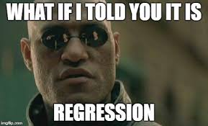
Machine Learning
Introduction to Linear Regression
What could impact sales ?
Population Density in the area
Disposable Income
Demographics of the region
Parking size of the location
No of other grocery stores in around (3km)
Credit card usage
Internet penetration/usage
Average no of cars/household
Avg family size/household
No of working people/household

Slide 15
Machine Learning
Sales = function (X1, X2, X3, X4,X5,X6……)
Sales = 10X1 + 20X2 +0.5X3 + 8X4 +…………
If the function is linear we call it linear regression
Now this was a example of Multiple Linear Regression, Let’s stop this topic for now and think in terms of two variables only, Say X and y. This we will called as Simple Linear Regression.

Slide 16
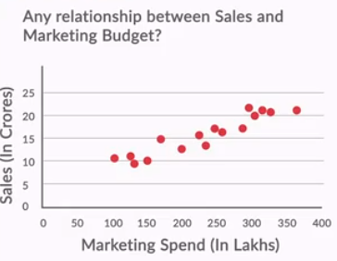
SLR
Simple Linear Regression
Let’s first check if there is any relationship between Marketing Budget and Sales? If there is no relationship we would not put any money in our Marketing budget as this is not contributing to sales.

Slide 17
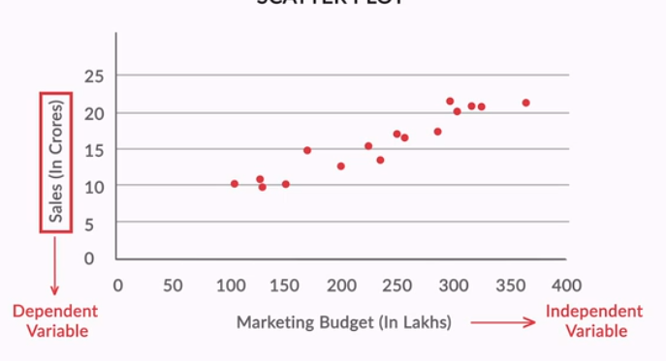
SLR
Simple Linear Regression

Slide 18
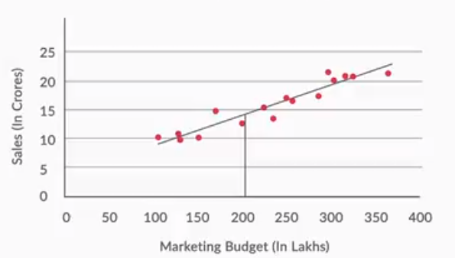
SLR
How to Make Prediction?

Slide 19
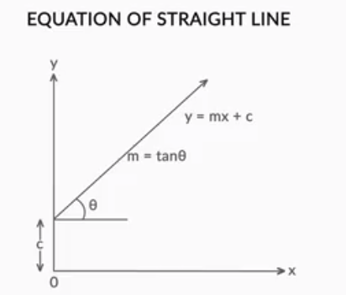
SLR
If there is zero marketing budget still we will observe C amount of sales.

Slide 20
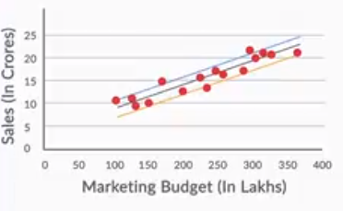
SLR
Best Fit Line

Slide 21
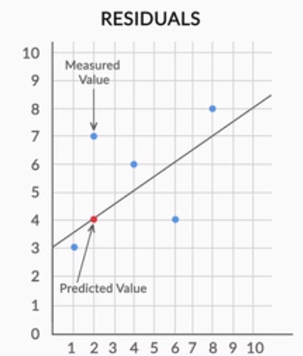
SLR
Best Fit Line

Slide 22
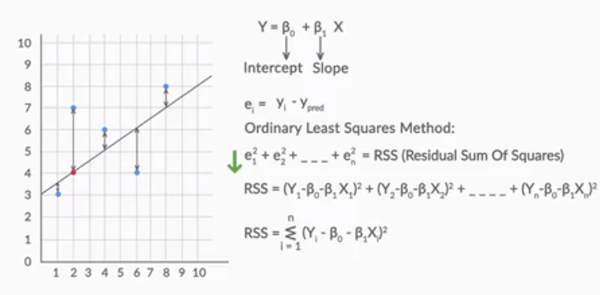
SLR
Best Fit Line

Slide 23
SLR

Slide 24
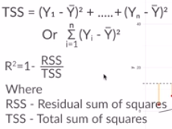
SLR
RSS and TSS
Demo using: https://da-upgrad.shinyapps.io/rsquared/
TSS represent error of the very basic model that
we can build without having any independent variable.
So any model that we build should be better from this basic model.

Slide 25
#LifeKoKaroLift
Let’s Test our Knowledge

Slide 26
Let’s Test
X | Y | Predicted Y Value | Error | Error Squared | Distance between Y values and their mean | Mean distances squared
1 | 3
2 | 4
2 | 5
3 | 6
4 | 6
Mean: |  | Sum: |  |  | Sum:

Slide 27
Let’s Test
Refer to the data that has one independent(X) and one dependent(y) variable.
The SLR equation for this data was found to be Ŷ = 1.5+1.5x
Using the information above, answer the following questions:
Question-1: Using the equation find the predicted values for all the observations. What is
the mean of the predicted values (round to nearest value)?
5
6
4
Question-2: Now find the error value between predicted and actual value (Ŷ-y). What is the maximum error value obtained?
1
1.5
2
X | y
1 | 3
2 | 4
2 | 5
3 | 6
4 | 6

Slide 28
Let’s Test
Question-3: What is the value for Sum of Squared Error?
2.5
2.75
3
Question-4: Now find the error value between y and ӯ(mean value of y). What is the maximum error?
1.5
1.2
1.6
Question-5: What is the value of TSS?
6.7
6.5
6.8

Slide 29

Let’s Test
Question-6: What is the R-Square of the model?
50%
60%
55%
Question-7: What is the MSE for the Linear Equation?
0.75
0.45
0.55
Question-8: In a simple linear regression problem, the following sum of squares are produced:
The percentage of the variation in y that is explained by the variation in x is:
25%
75%
33%
50%

